Slide 1
An Implementation for Combining Neural Networks and Genetic Algorithms
Md. Mijanur Rahman, Tania Akter Setu
International Journal of Computer Science and Technology
July, 2015, Vol. 6, Issue 3, pp. 218 - 222
Reporter: Tzu-Jui Huang
Date: 2018/06/12

Slide 2
Outline
Introduction
Genetic algorithm
Neural network
Encoding the network
GANN approaches
Experiments

Slide 3
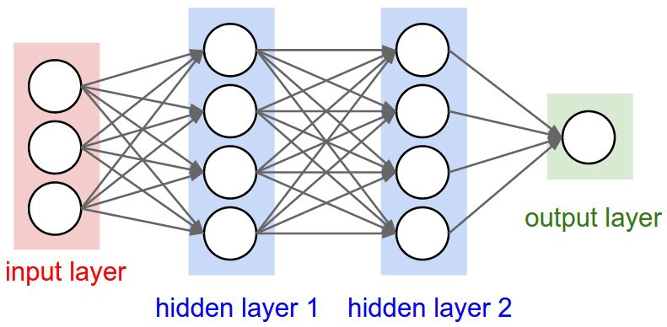
Introduction
Neural networks used as a learning system.
Genetic algorithms as an optimization system.
The choice of the basic parameter is the requirement of the success of the training process.
Fig. 1. A neural network architecture.
Notes:
network topology, learning rate, initial weights
Parameter problem

Slide 4
Introduction
By combining genetic algorithms with neural networks (GANN), the genetic algorithm is used to find these parameters.
The topic of this research is the question of how exactly GA and NN can be combined.

Slide 5
Genetic algorithm
A genetic algorithm (GA) tries to simulate the natural evolution process. Its purpose is to optimize a set of parameters.
A genetic algorithm (GA) is great for finding solutions to complex search problems.

Slide 6
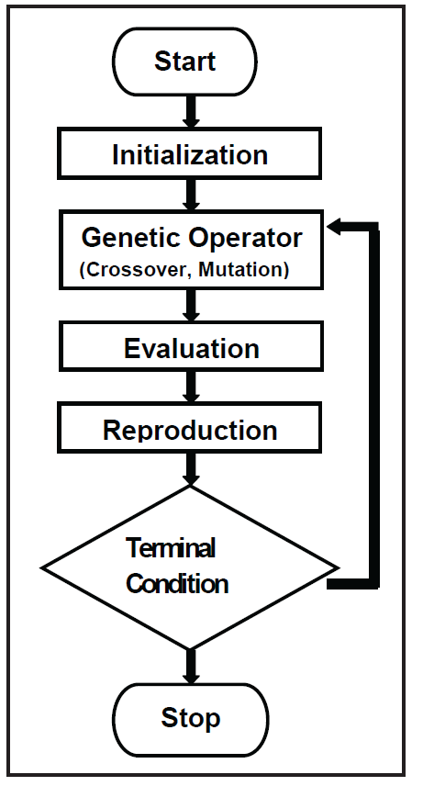
Genetic algorithm
Fig. 2. Flowchart of genetic algorithm.

Slide 7
Neural network
An artificial neural network (ANN) is information processing system that is inspired by the way biological systems.
It is composed nervous of a large number of highly interconnected processing elements (also called neurons) working with each other to solve specific problems.

Slide 8
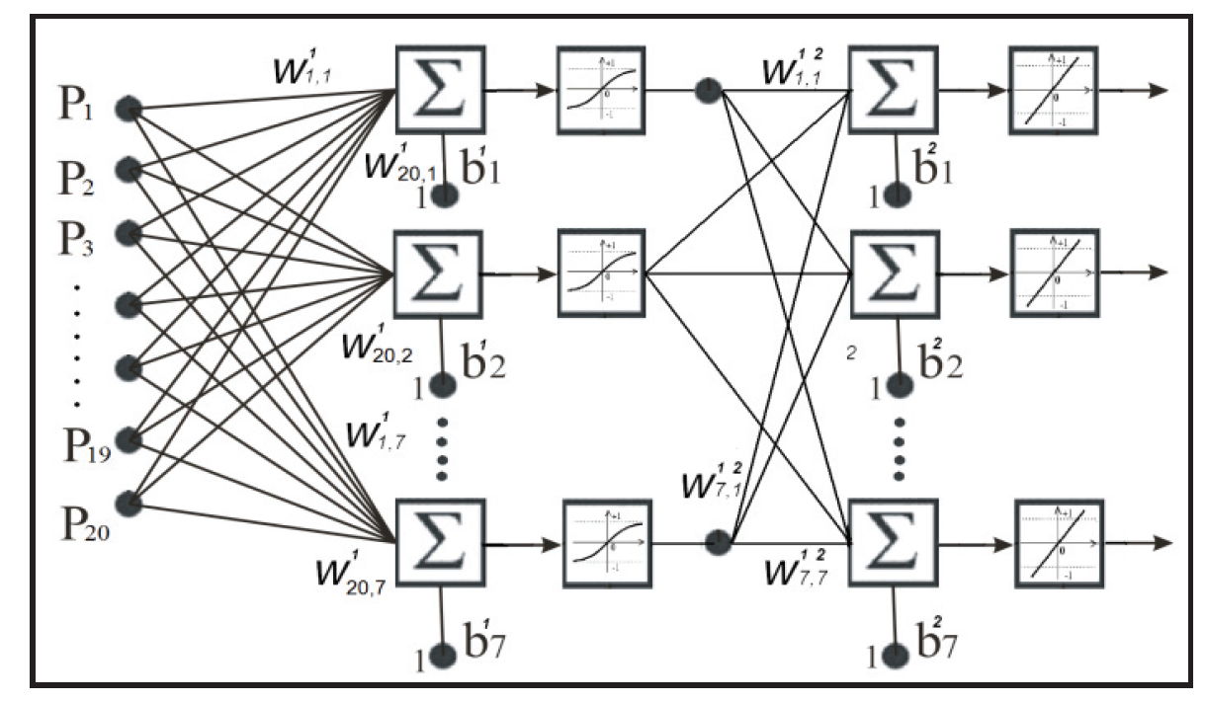
Neural network
Fig. 3. The architecture of a feed forward neural network with 20 neurons in input, 7 in hidden layer and 7 in output layers.

Slide 9
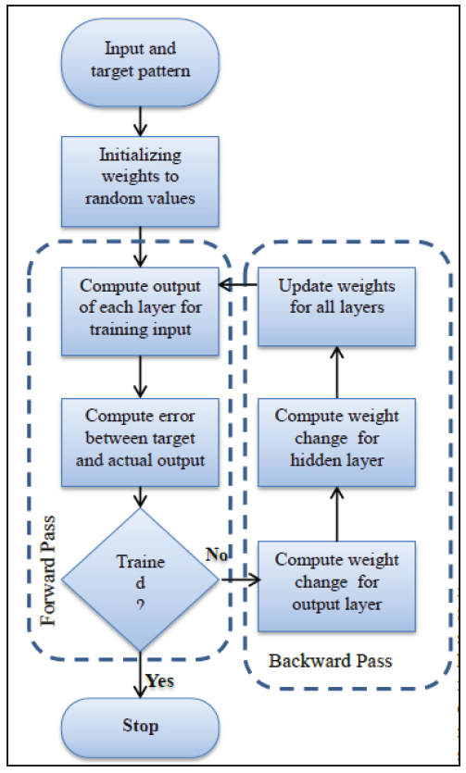
Neural network
Fig. 4. Flowchart of backpropagation algorithm for training
neural network.

Slide 10
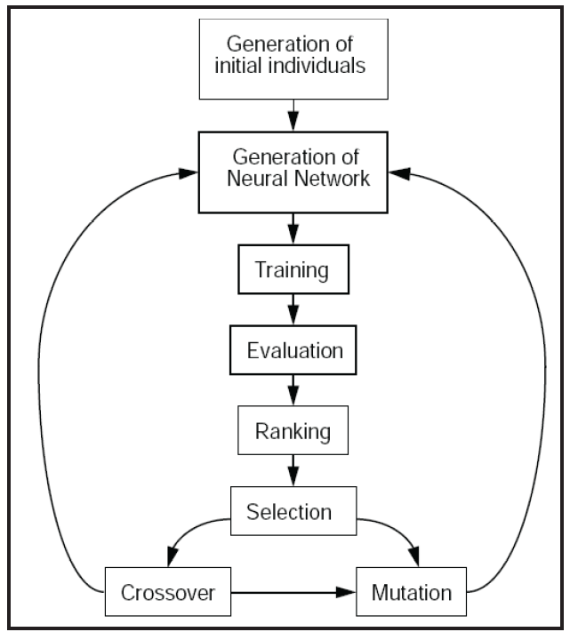
Encoding the network
Fig. 5. The principle structure of a GANN system.

Slide 11
GANN approaches
Supportive and collaborative approach
Supportive approach
The most common combination is to use a GA to preprocess the data set that is used to train a NN.
Neural networks and evolutionary algorithms are used independently at different stages of the problem.
Collaborative approach
Learn artificial neural network connection weights that are coded, as binary or real numbers, in a genetic algorithm string.

Slide 12
GANN approaches
Combining process
Using GA to train NN: The weight of the network use as a population of GA by making the string and GA evaluate the fitness.
The following steps are worked to train the neural network with genetic algorithm.
Step-1: Set weights in the network, are joined to make one string.
Step-2: Define the network.
Step-3: Use this string in the GA as a member of the population.
Step-4: Train the weight until obtain the target output.

Slide 13
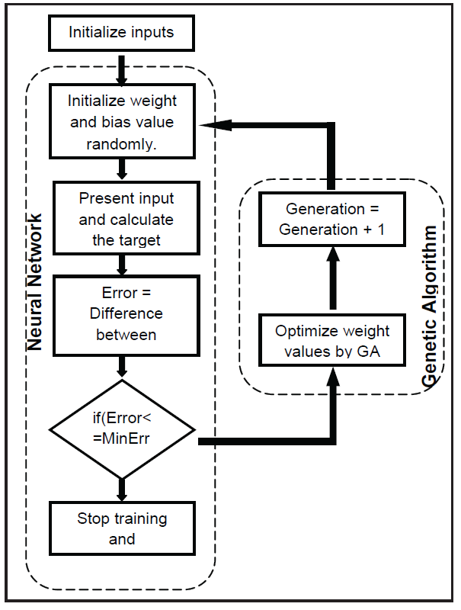
GANN approaches
Fig. 6. Flowchart of BP neural network optimization by genetic algorithm.

Slide 14
GANN approaches
Define neural network
10 input and 10 output and 2 hidden neurons.
Weight initialization
Weights and bias values have been initialized randomly. The mean square error function has been used to calculate error.
Genetic algorithm optimization
The genetic algorithm finds the best fitness value corresponding to the individual by means of the selection, crossover, and mutation.

Slide 15
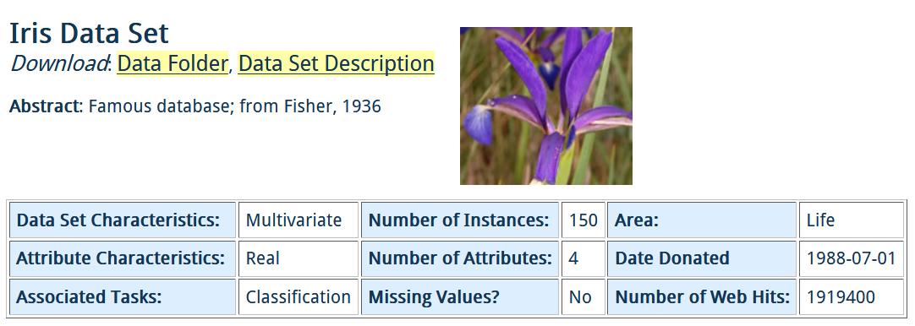
Experiments
Fig. 7. Iris data set.

Slide 16
Experiments
Attribute
Sepal length in cm
Sepal width in cm
Petal length in cm
Petal width in cm
Class
Iris Setosa
Iris Versicolour
Iris Virginica
http://archive.ics.uci.edu/ml/datasets/Iris
5.3, 3.7, 1.5, 0.2, Iris-setosa
5.0, 3.3, 1.4, 0.2, Iris-setosa
7.0, 3.2, 4.7, 1.4, Iris-versicolor
6.4, 3.2, 4.5, 1.5, Iris-versicolor
6.3, 3.3, 6.0, 2.5, Iris-virginica
5.8, 2.7, 5.1, 1.9, Iris-virginica
Fig. 8. Numerical data set.
Notes:
萼片、花瓣
山鳶尾、變色鳶尾、維吉尼亞鳶尾

Slide 17
Thanks for Your Attendance!

